Slide 1

Tech Bazar
Best Tech Website
Hamza Ahmed Bhutta 18F0368
Fahad Usman 18F0181
Sheroz Khalid 18F0319
Supervisor:
Mr. Masood Habib
Co-Supervisor:
Mr. Umar Aftab

Slide 2

Project Introduction
The purpose of this document is to highlight, analyze and to have a better understanding of the high-level requirements of the system.
It focuses on the capabilities needed by the stakeholders, and the targeted users, and why these needs exist.
This will help us in identifying and reducing the potential risks of the system.

Slide 3
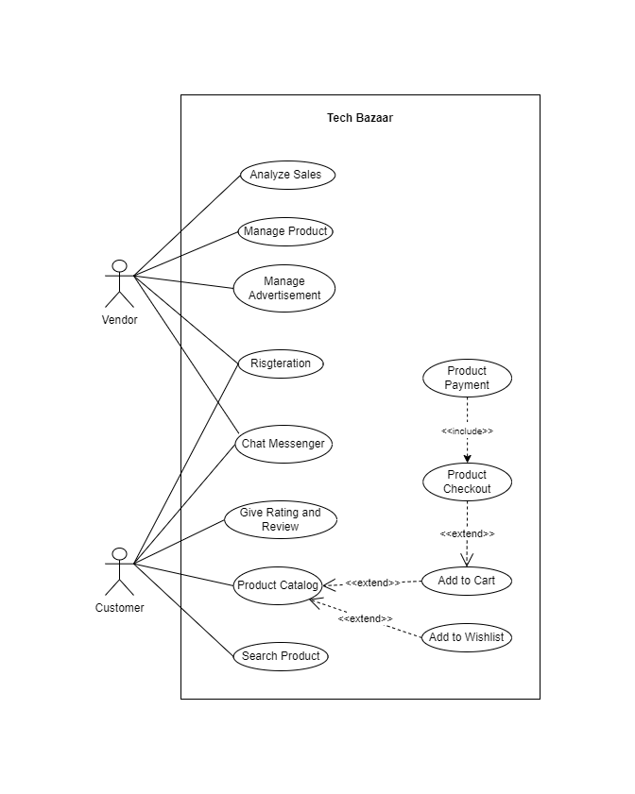
Use Case Diagram

Slide 4
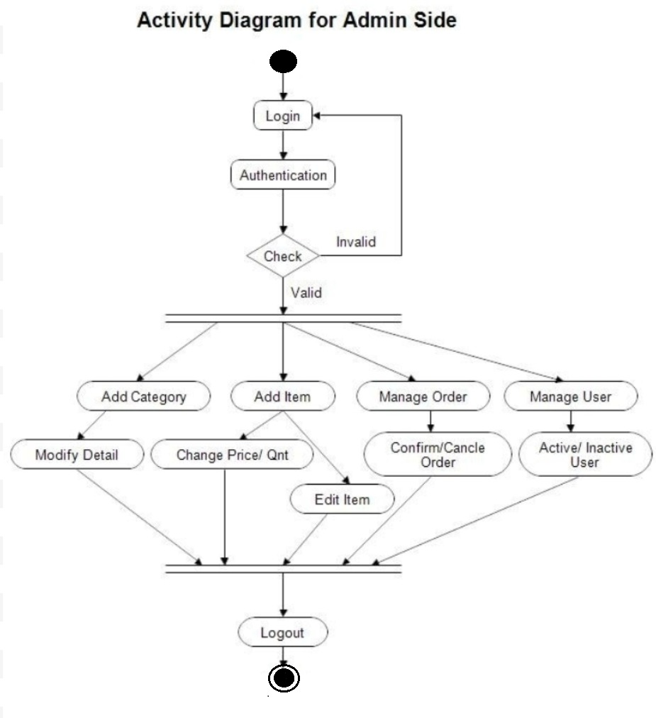
Activity Diagram

Slide 5
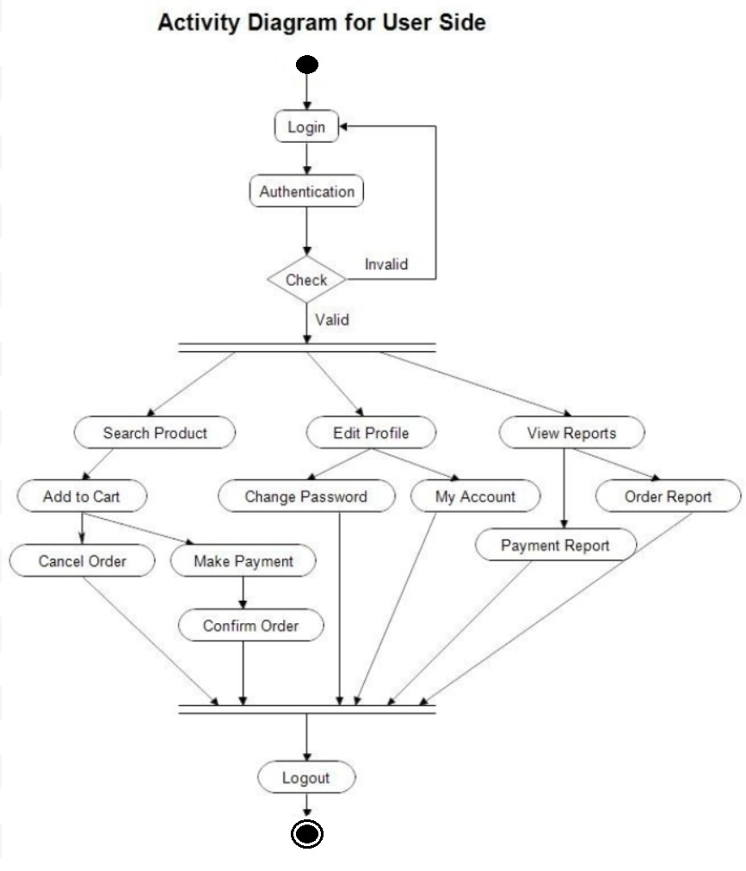
Activity Diagram :

Slide 6
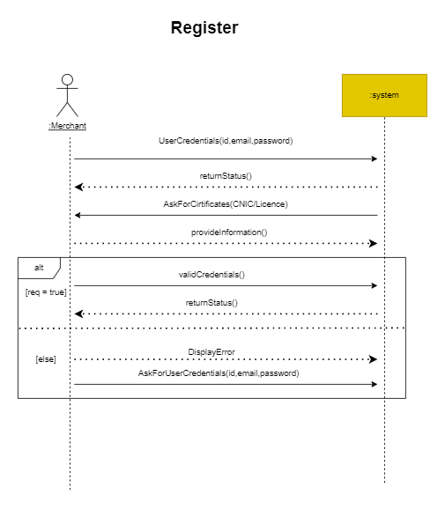
Register
System Sequence Diagram

Slide 7
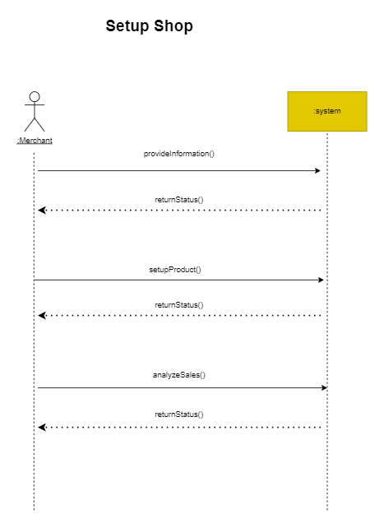
Setup Shop
System Sequence Diagram

Slide 8
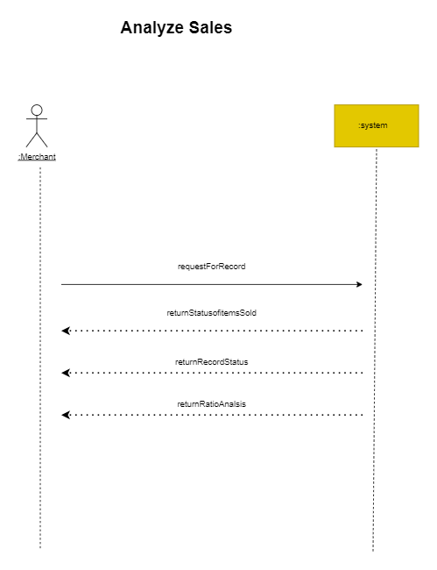
Analyze Sales
System Sequence Diagram

Slide 9
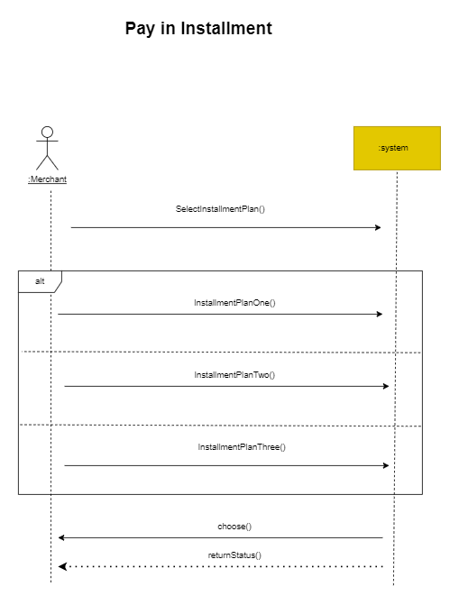
Pay in installment
System Sequence Diagram

Slide 10
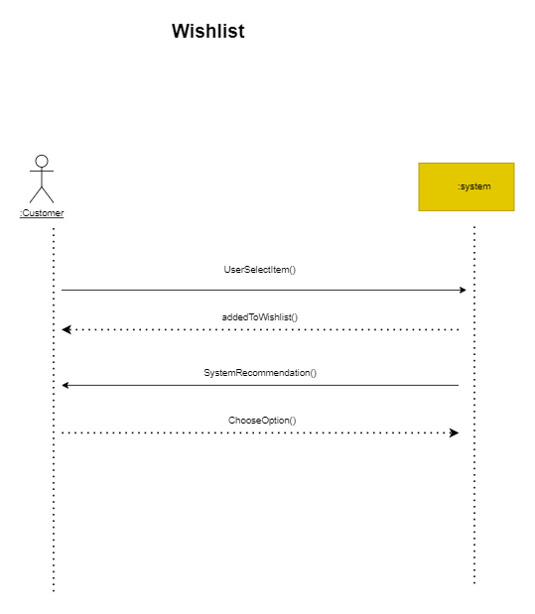
Wishlist
System Sequence Diagram

Slide 11
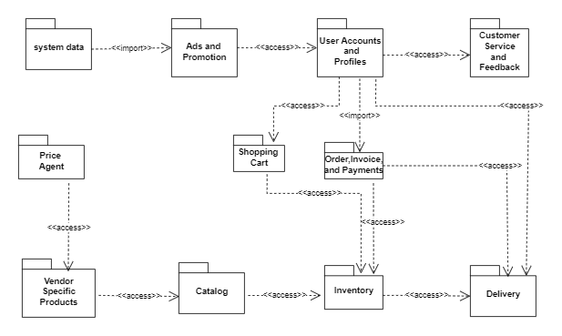
Package Diagram

Slide 12
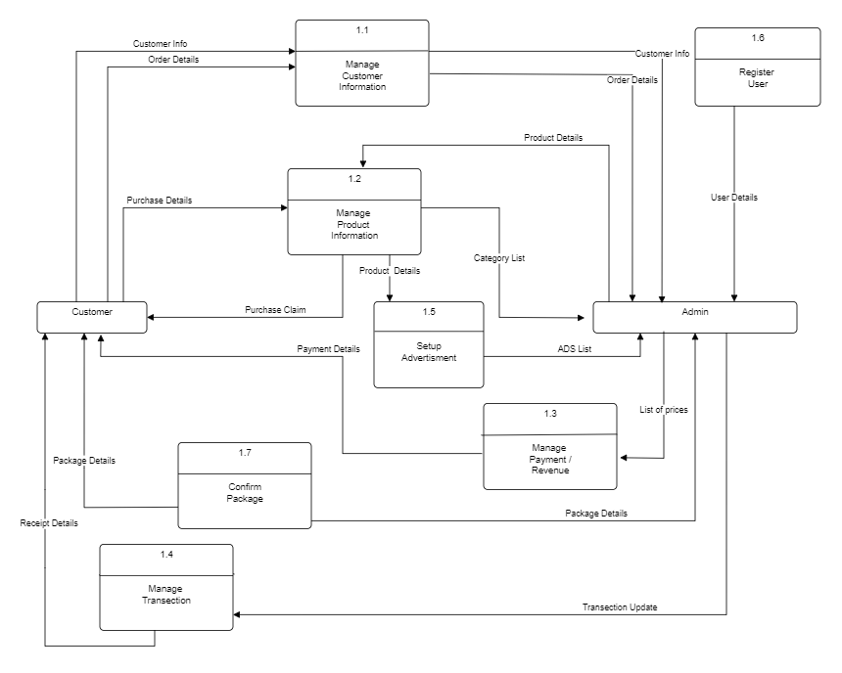
Data Flow Diagram

Slide 13
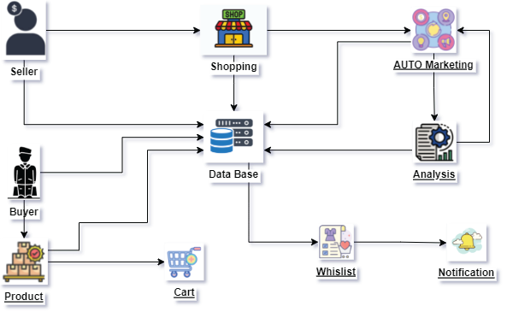
Architecture Diagram

Slide 14
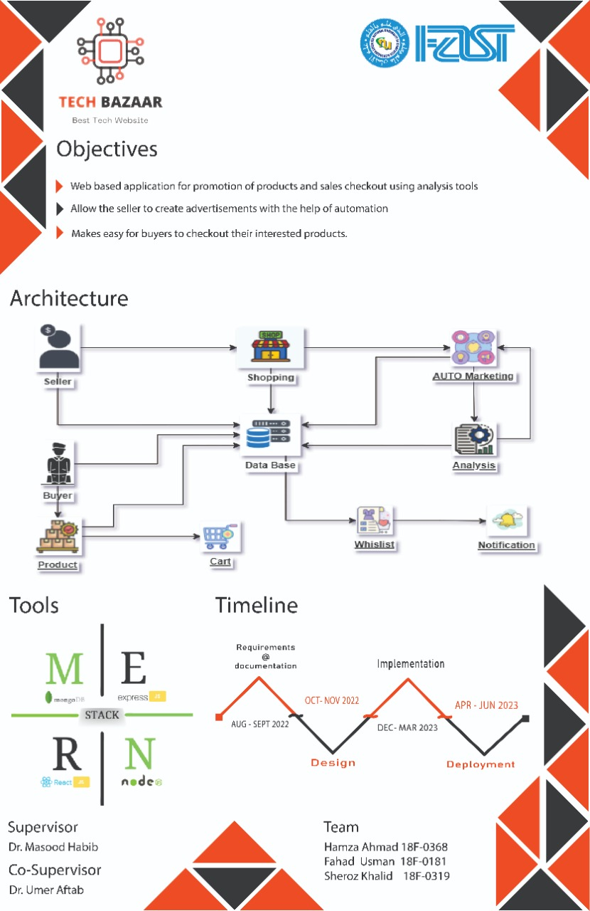
Posture :

